Slide 1

DISTANCE
DETECTION
DEVICE

Slide 2
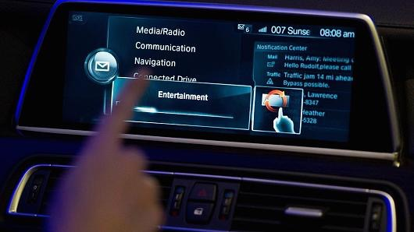
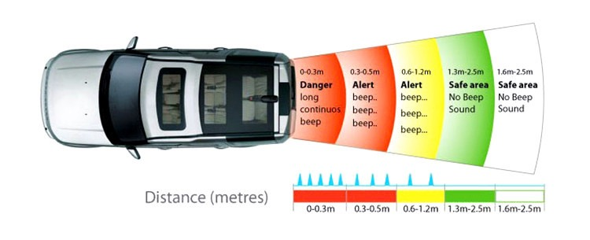
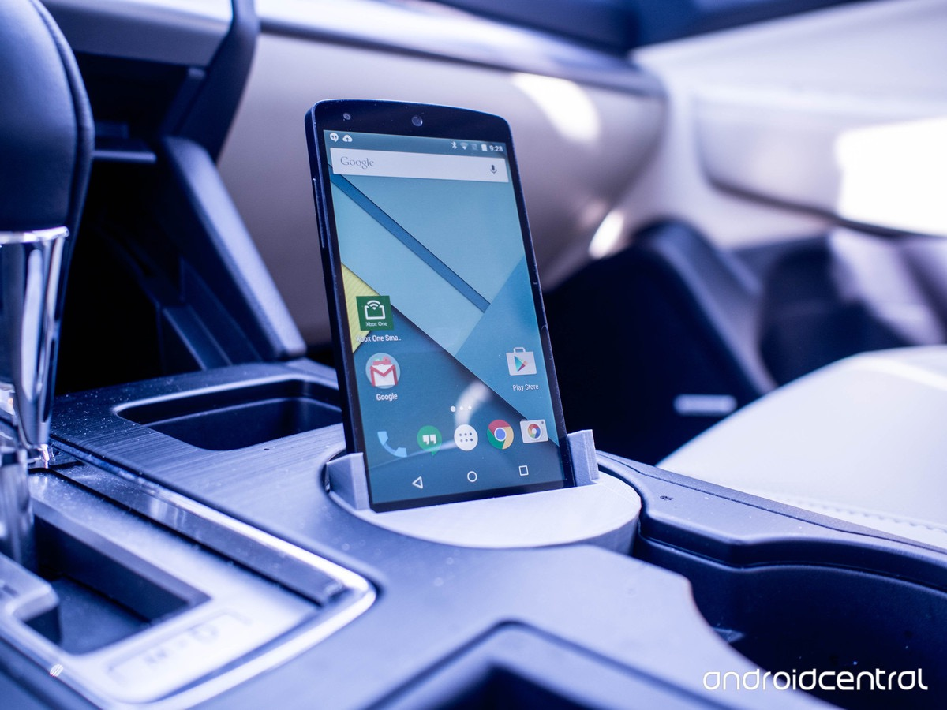
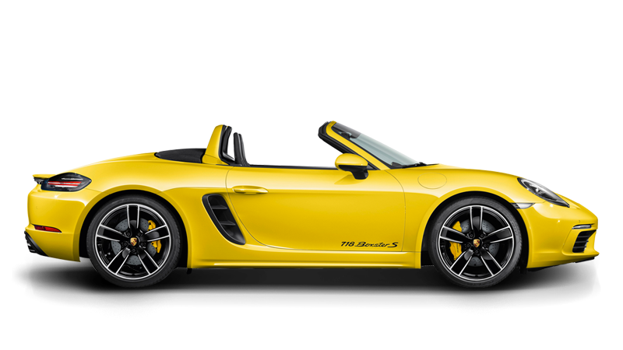
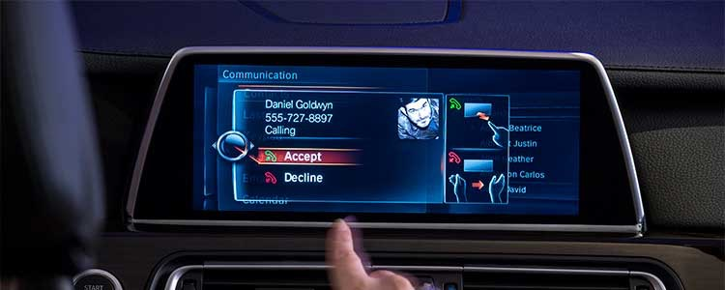
Idea & Concept
Software
Hardware
Android app that connected to the hardware via Bluetooth to get and display distance from object a far.
Raspberry Pi connected with sensor
Mounted in front of a car or behind the car to assist users in parking and avoid collision.

Slide 3
THE ABOUT
PROBLEMS
Older vehicles systems doesn’t have smart detection system.
Cost for detection system too expensive.
Vision
and Mission
INTENDED MARKET
Car owners without distance detection systems, assisting in parking and driving.
WHY
A cheap alternative to distance detection for vehicles.
INTERNET OF THINGS
First steps for IoT application in the future.

Slide 4


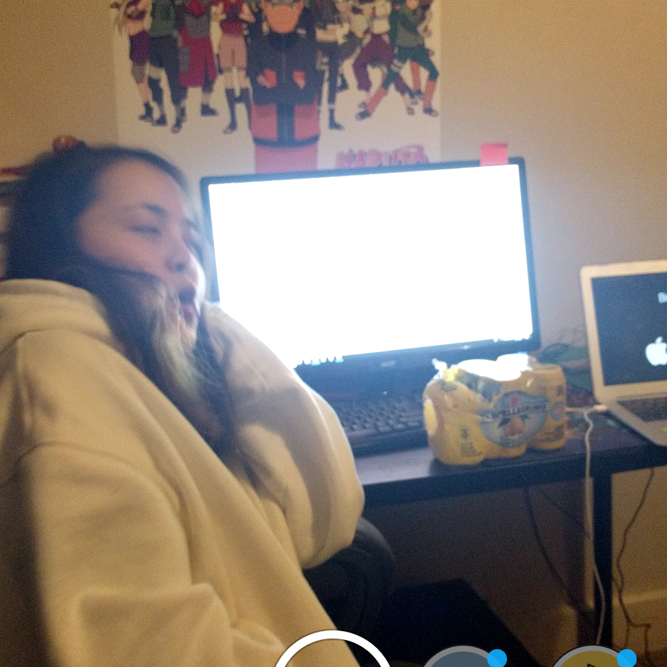
Team UNI
Derek Do
Lead Designer
Brian Rojas
Lead Programmer
Lu Liu
Lead Project Manager

Slide 5
Method
CONCEPT
DESIGN
DEVELOP
TESTING
1
2
3
4
The team used a combination of Scrum and Kanban

Slide 6
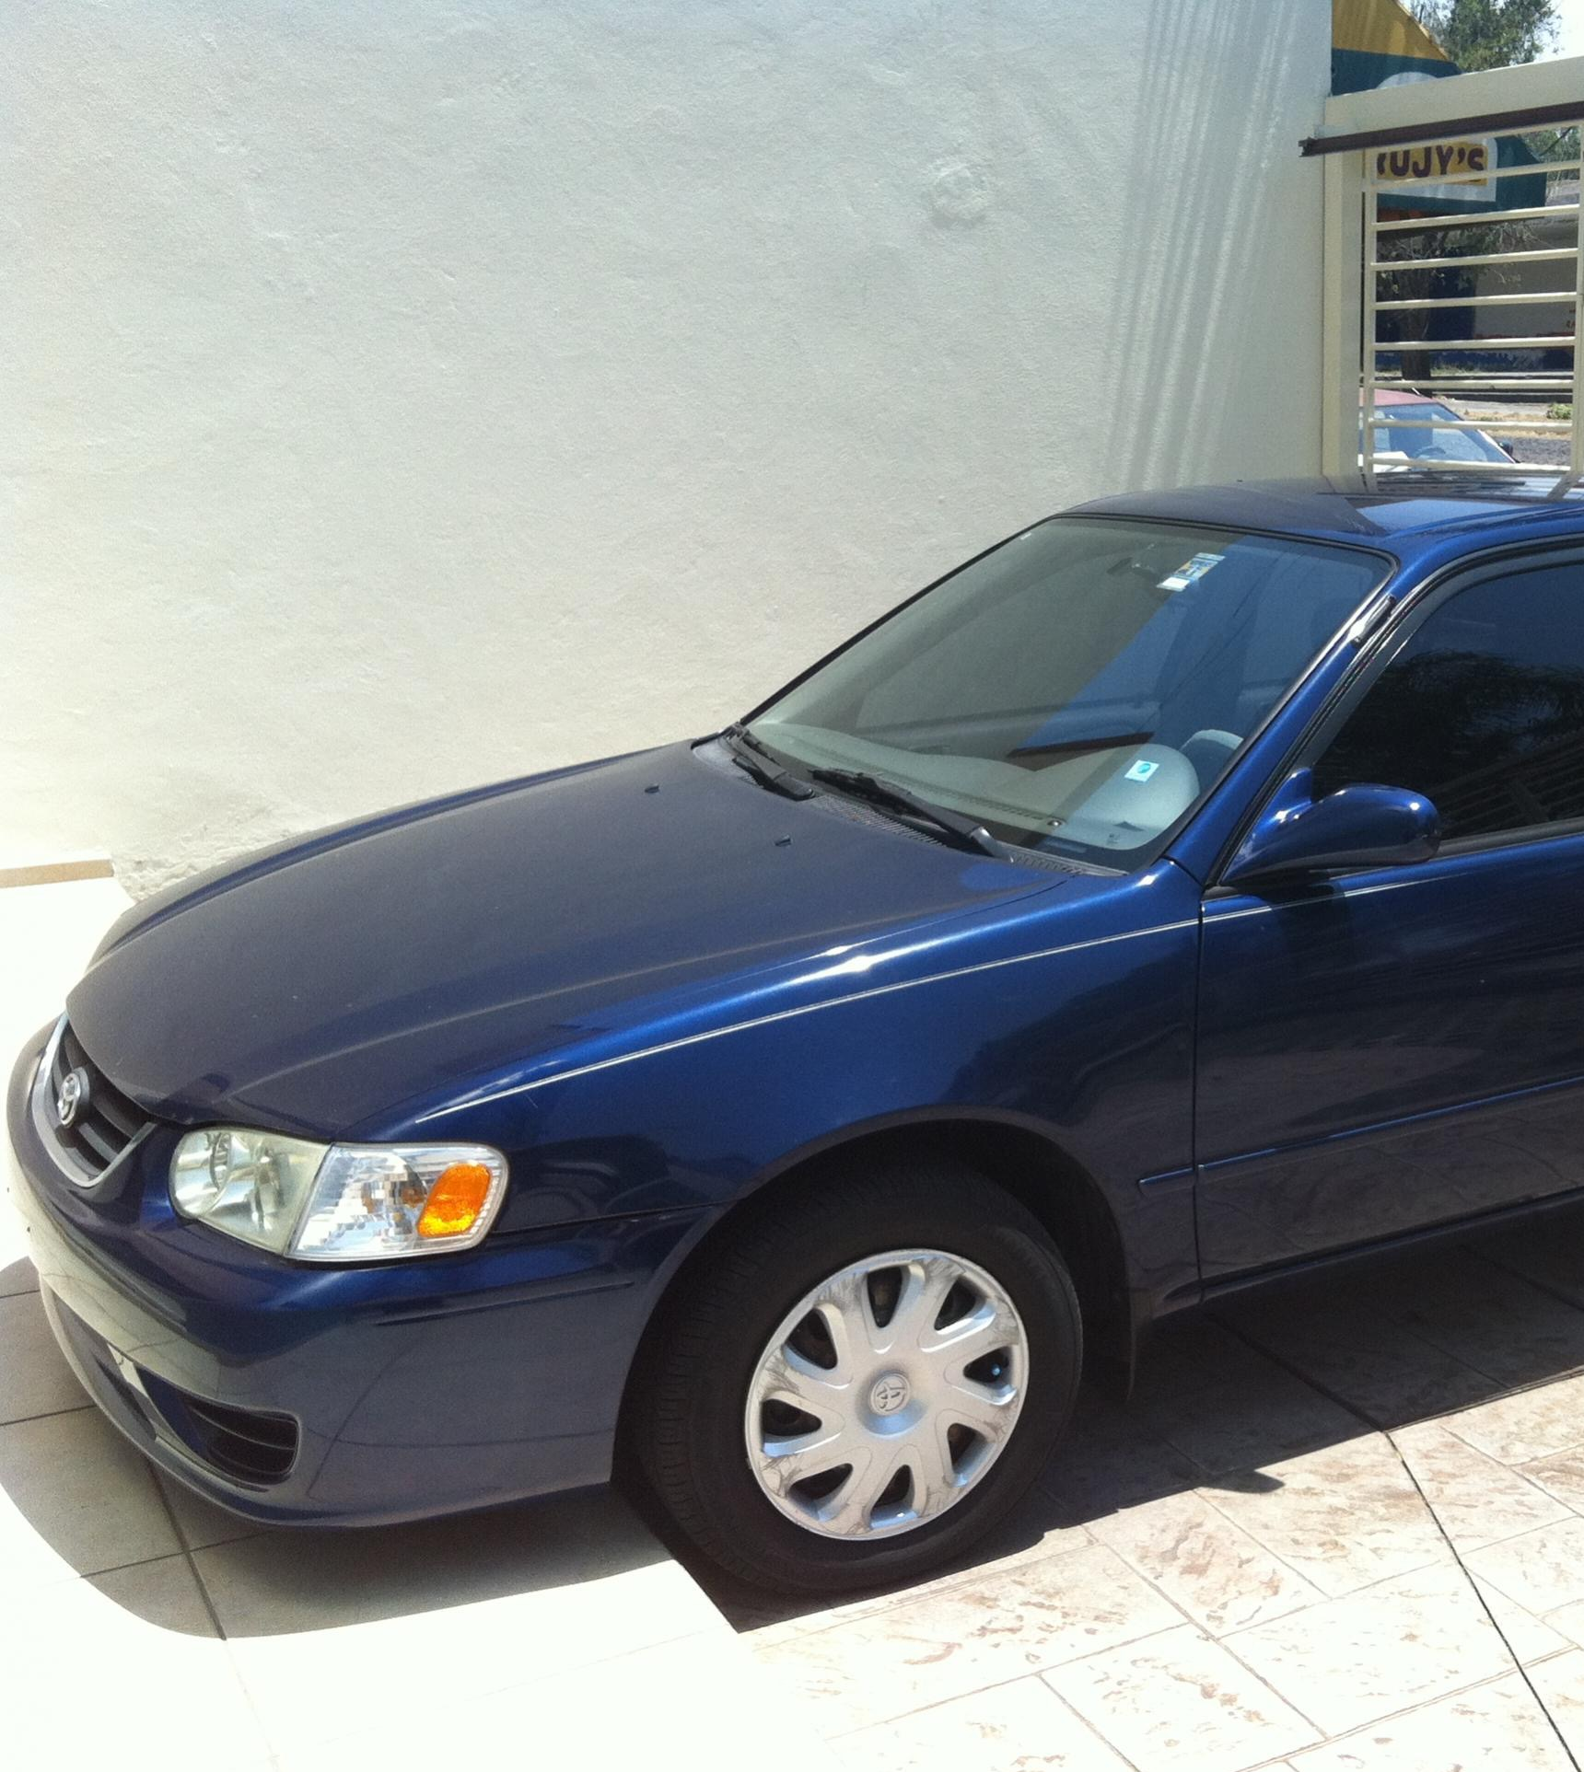
Concept
15 Oct.
Plan ideas.
Research about and hardware and software.
Requirement analysis.
Timeline planning.

Slide 7
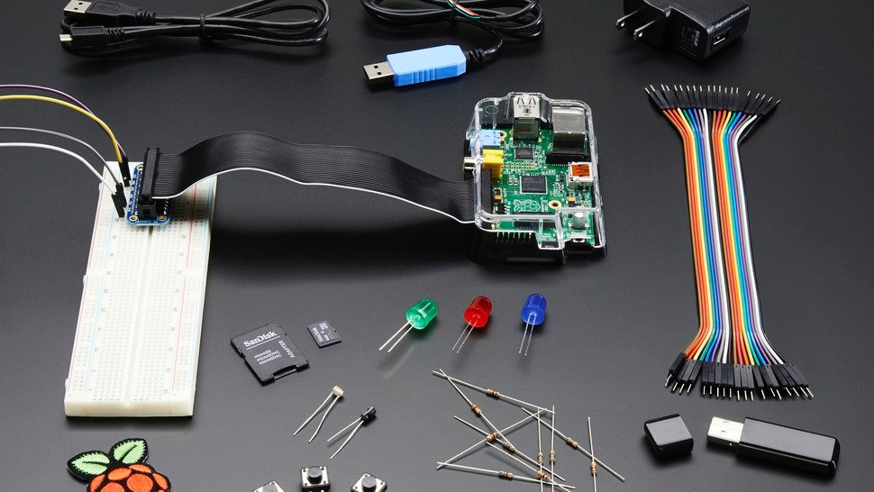
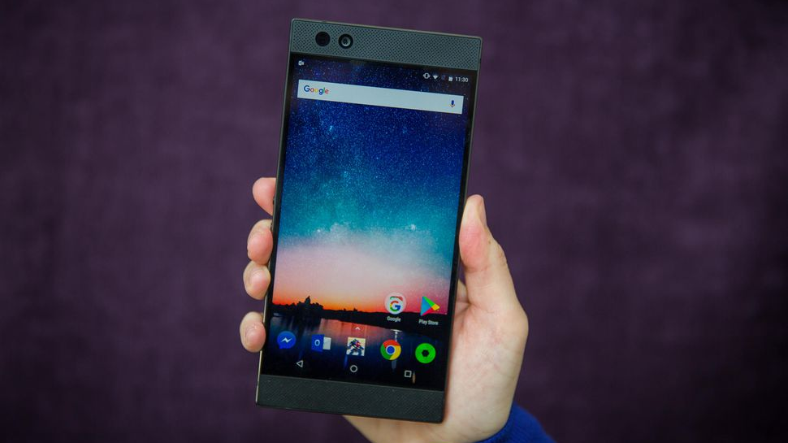
Design
30 Oct.
Design UML.
Design GUI.
How to assemble hardware.
Implementation
Oct 10th
Program the hardware to detect object.
Translate GUI designs into code.
Build the Android app.
Integrate Bluetooth API to exchange information between 2 devices.
Code tuning.

Slide 8
Testing
Dec. 1
Test hardware accuracy and stability
Deploy Android app on real devices
Take user feedback and improve
Code tuning.

Slide 9

Milestone Timeline
2017
May
Jun
Jul
Aug
Sep
Oct
Nov
Dec
2018
2018
Concept phase
15th – 30th
Implementation
30th – 2nd
Testing
3rd – 3^{nd – 18th}
Design
25th – 10th
Notes:
Brian

Slide 10
POWER
Functional
Android System 4.0+ compatibility.
Distance is displayed at the push of a button
Bluetooth connection is established at the beginning of the apps launch
App alerts user by a sound if they are too close.
User is able to turn the device on and off from the phone
- Display a disclaimer: “user should not rely on the application and that the developer do not take fault in any accidents” at startup.
- Device and apps should work reliably and smoothly.
Non-functional

Slide 11
SAFE😇
EXPECTED 😤
REACH🙃
-Deploy android application.
-Integrate Bluetooth API to exchange information between devices.
-Solar powered
- Color change, instead of sound alarm.
- Purchase all necessary parts and assemble correctly.
-Detection code is built and works reliably at an iterative manner.

Slide 12
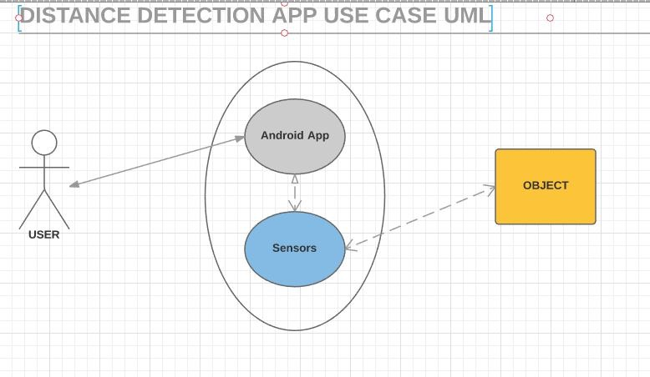
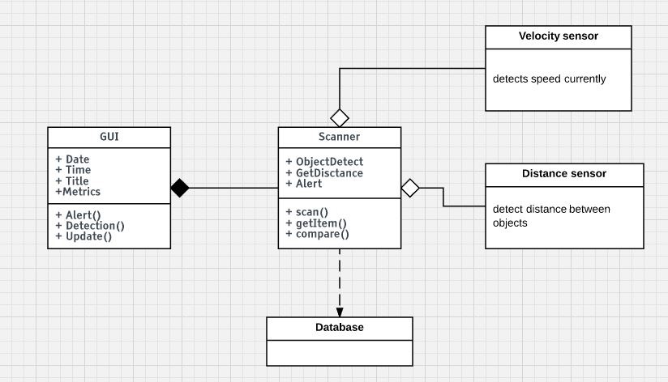
USER CASE UML
CLASS DIAGRAM UML

Slide 13
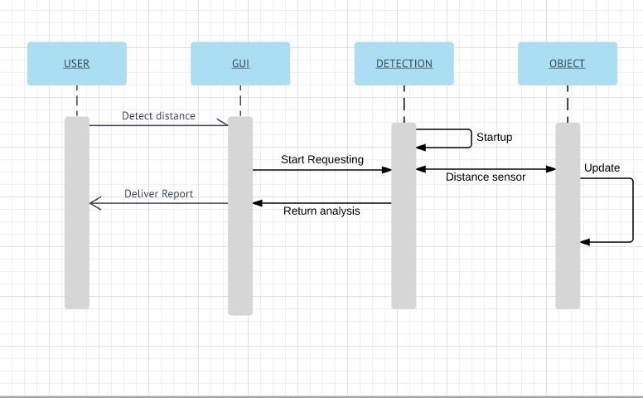
30
MAY
2016

Slide 14
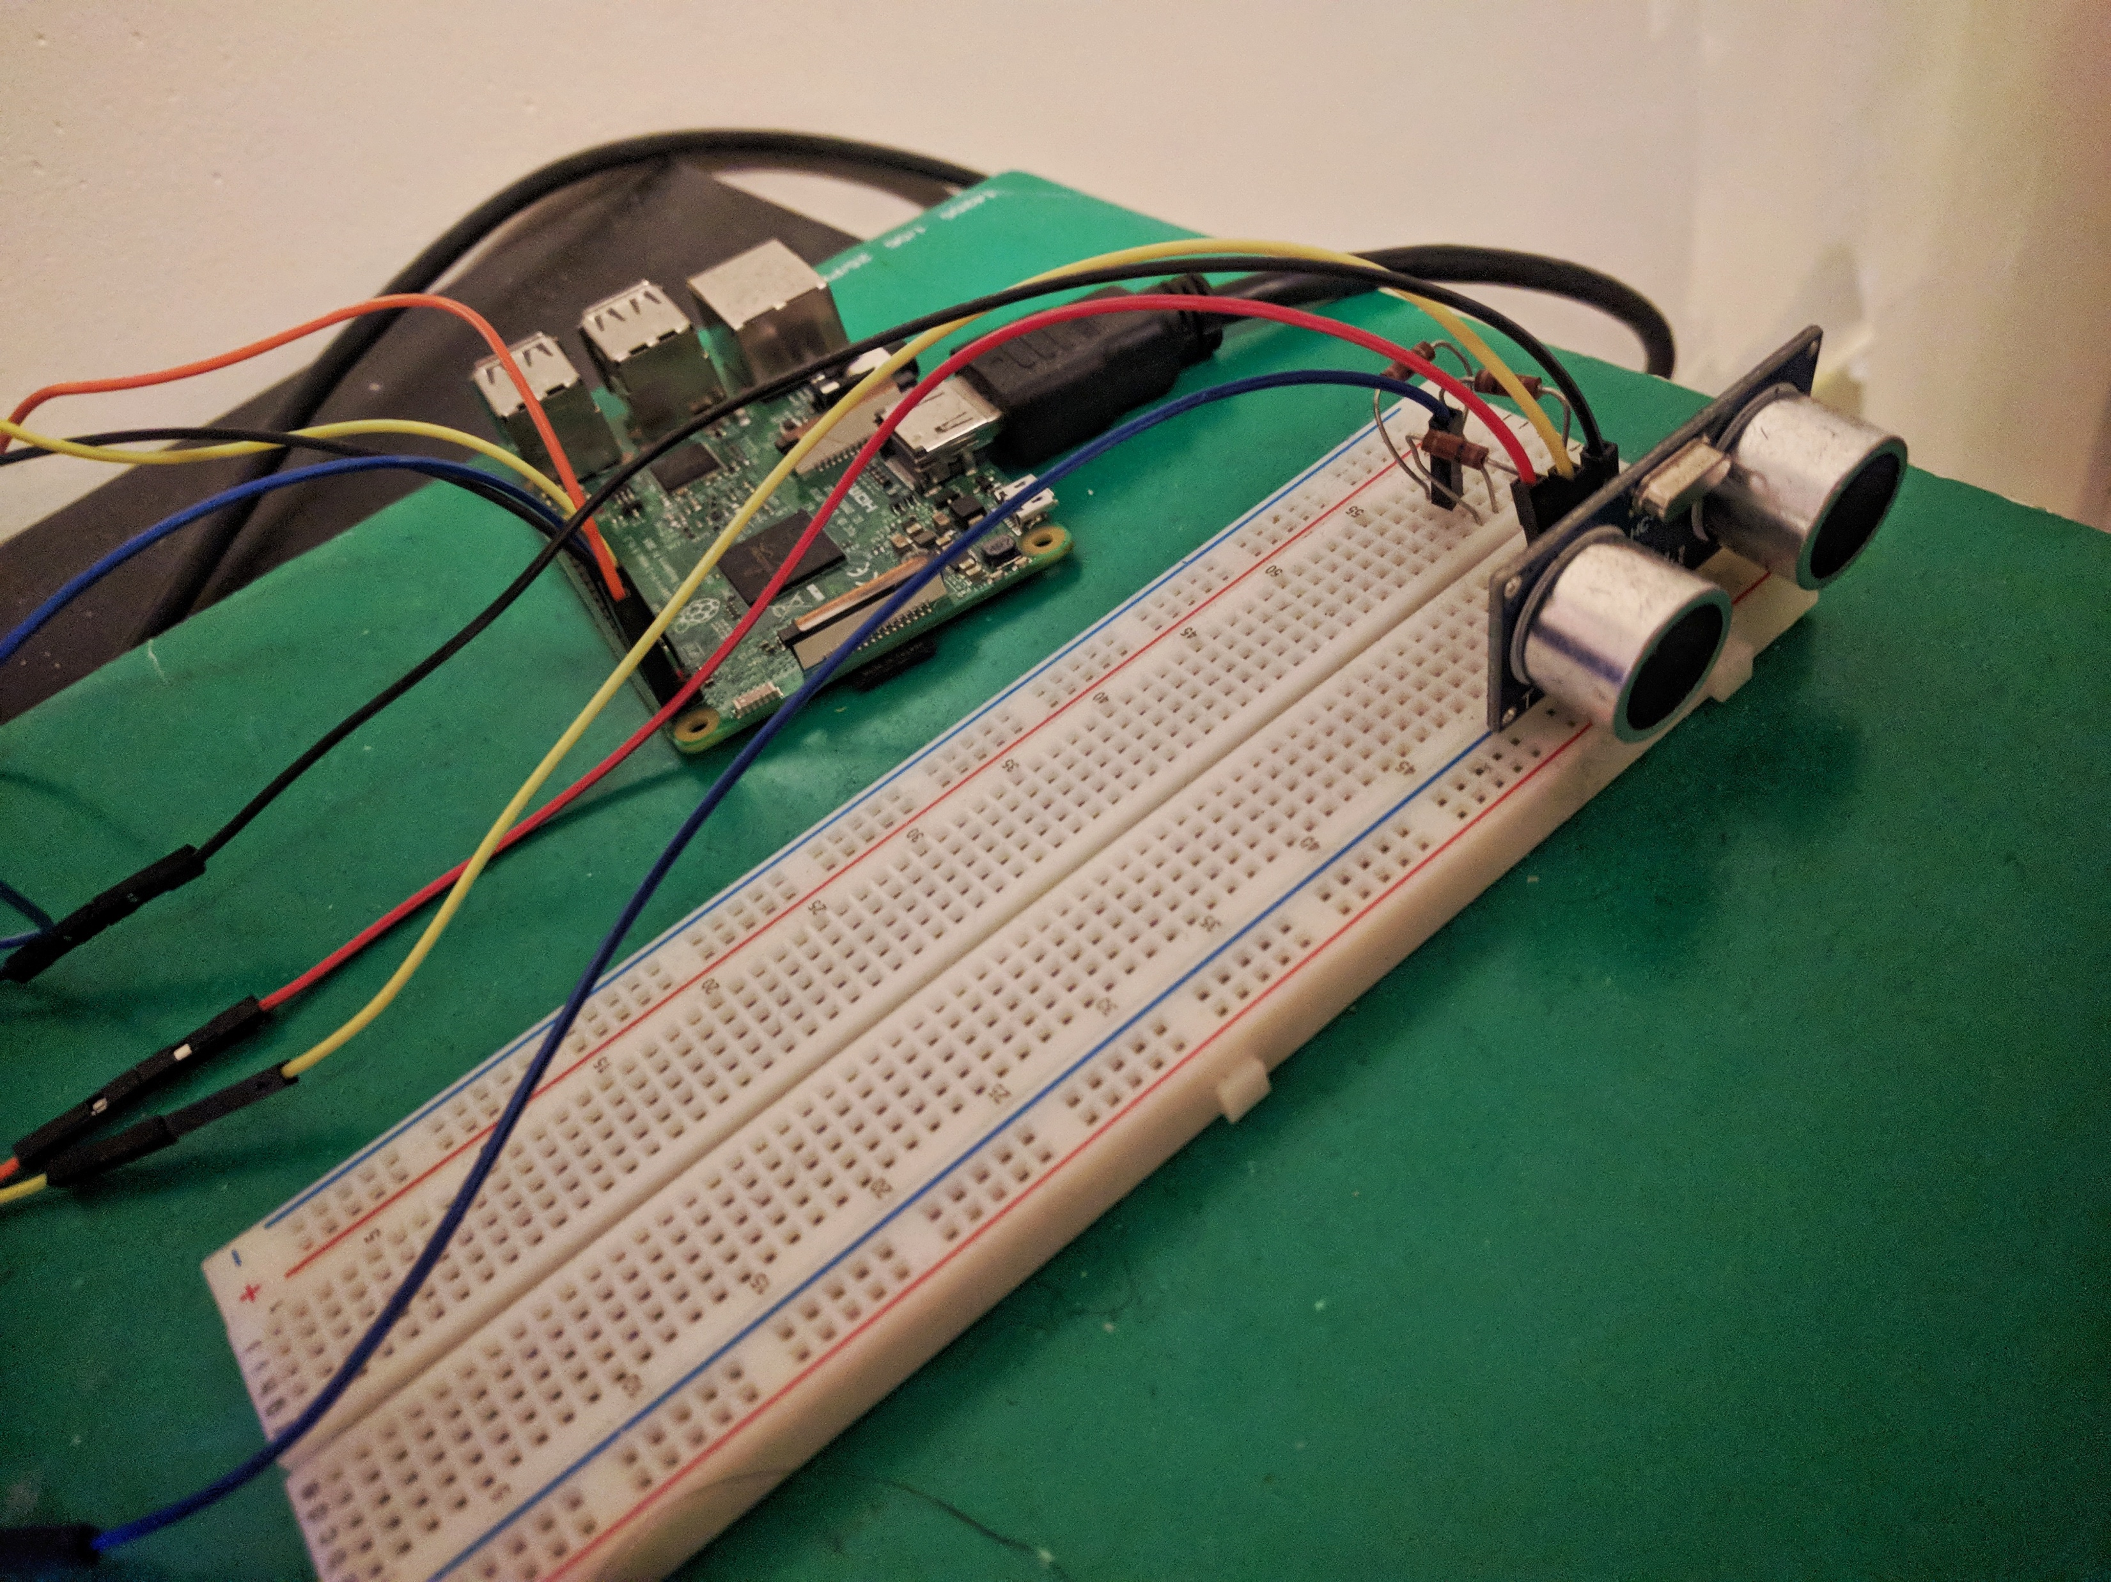
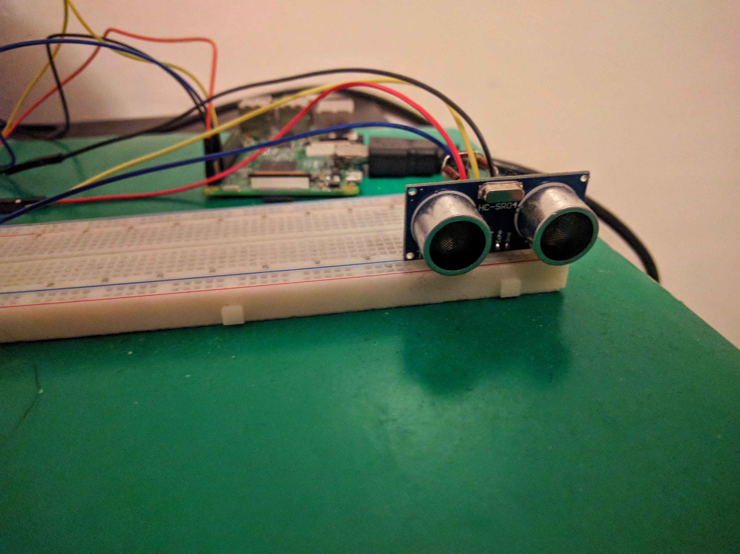
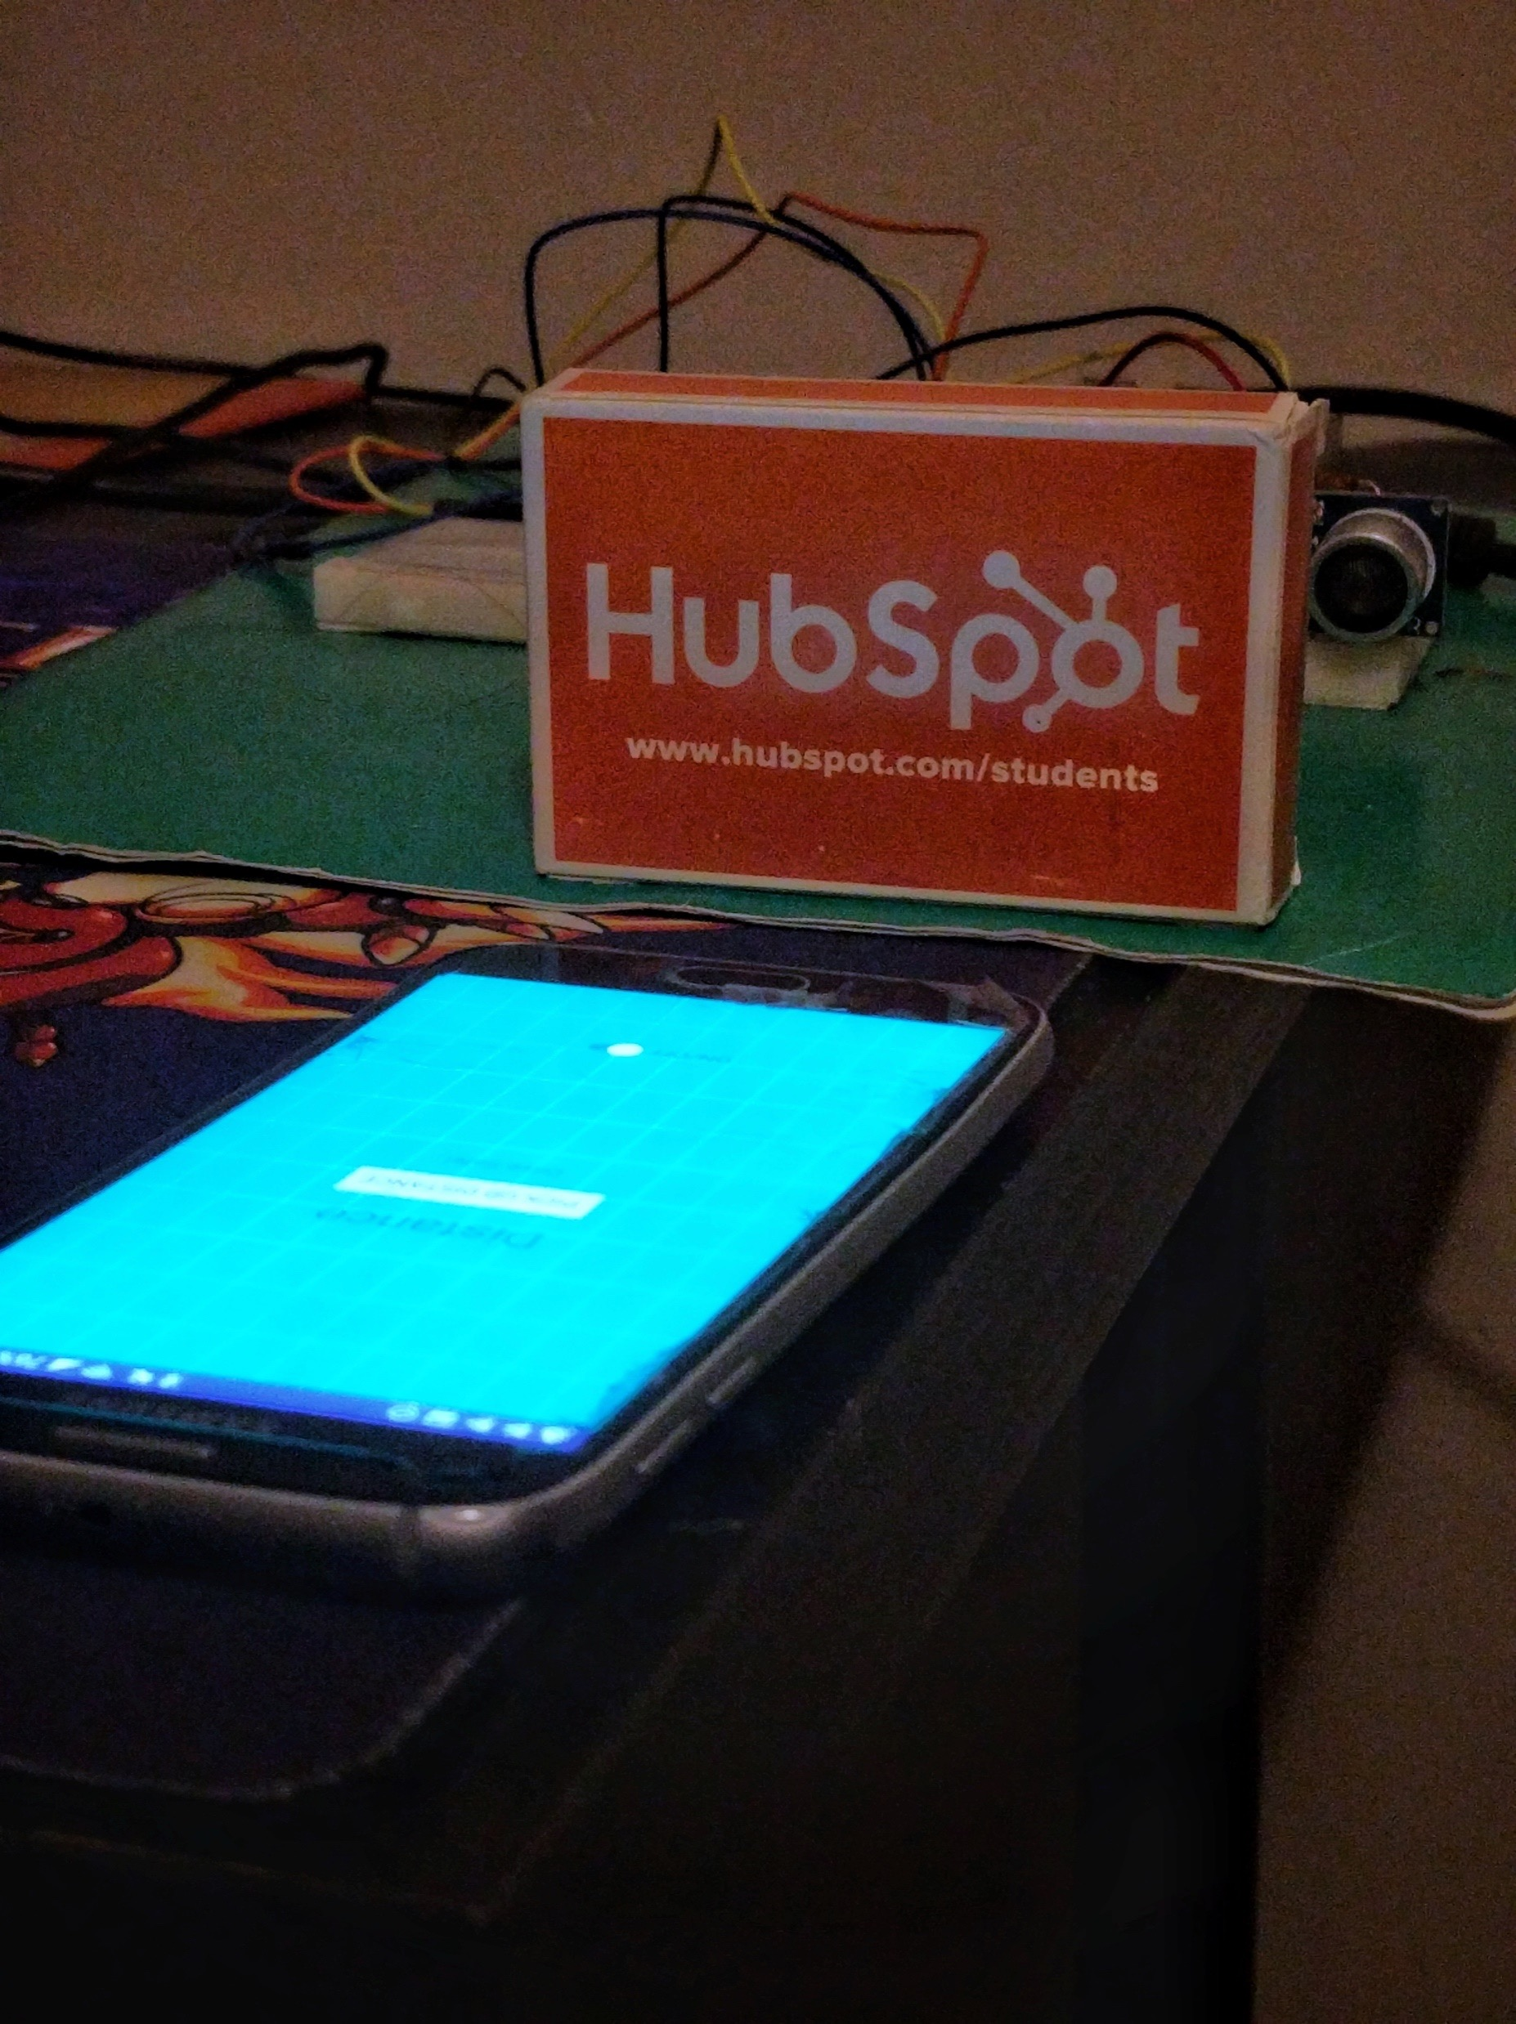
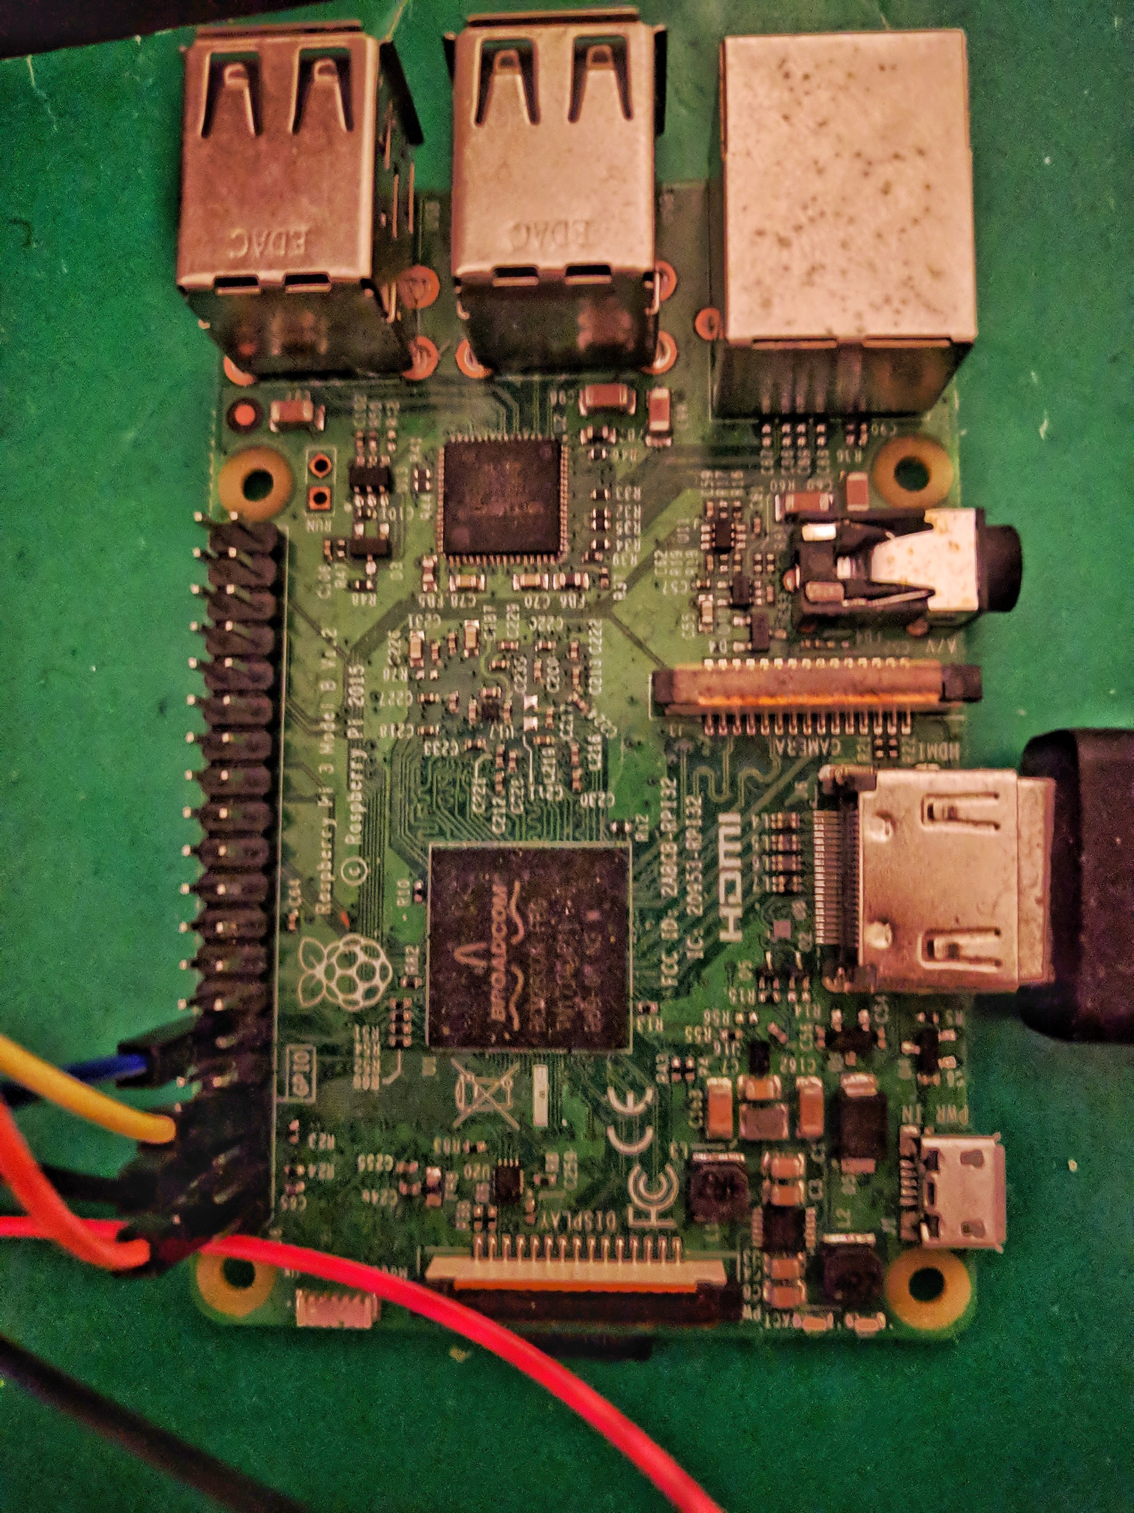
Product
Gallery
PRODUCTS

Slide 15
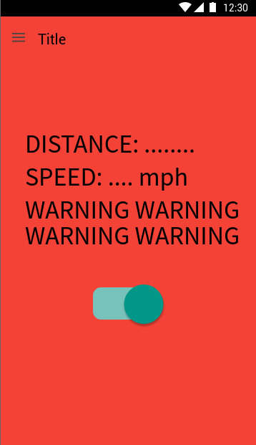
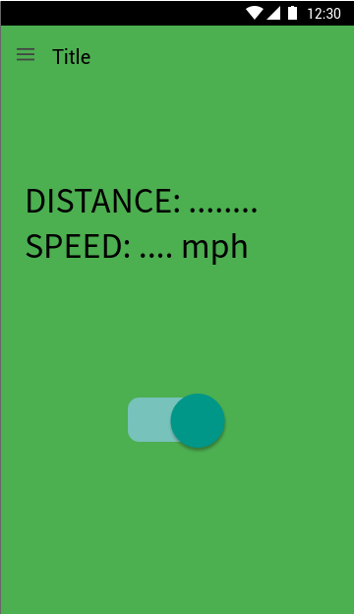
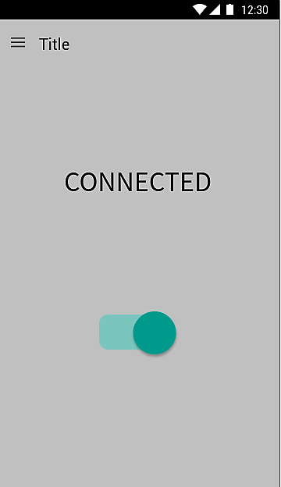
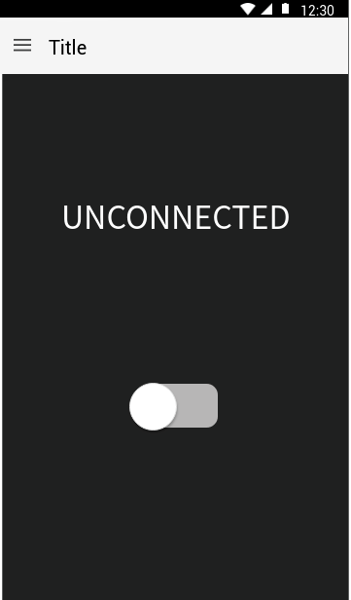
APPLICATIONS
GUI
mockup
Minimal UI requires minimal interactions for less distractions for vehicles owner.

Slide 16
ACCURATE
RELIABLE
SECURE
CROSS-PLATFORM
PERFORMANCE
USABILITY

Slide 17
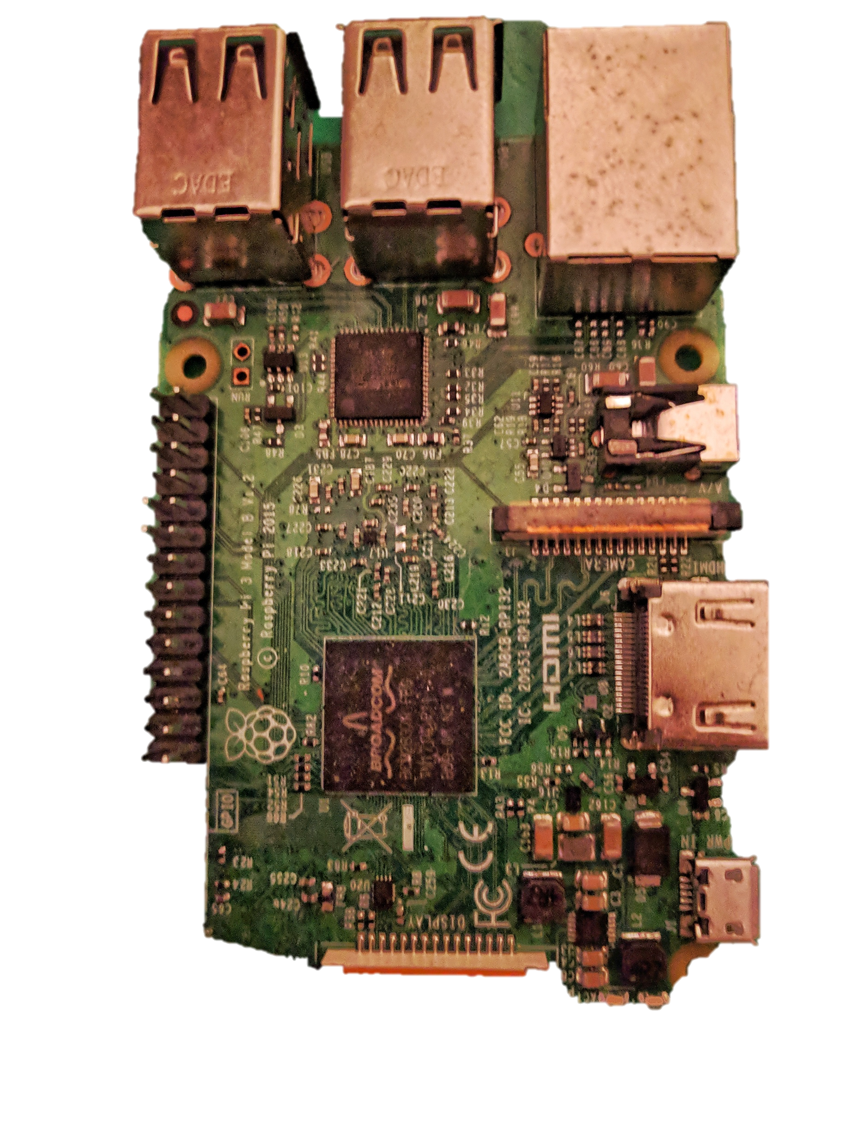
Hardware
Raspberry Pi 3.0
VCC, TRIG, ECHO, GRD
HC-SR04 Sensor
Noobs OS
Transistors
Bluetooth

Slide 18
Software
ANDROID STUDIO
BLUETOOTH
JAVA
PYTHON

Slide 19
Road Blocks
01
SYSTEM
02
TIME
03
CODE
Purchasing the system
Figuring out how the system mechanics works properly.
Learning Time
Implementation Time
Time of Execution
Bugs
Bugs
Bugs
Optimization
04
SKILL-SET
05
RESOURCES
Python Experience
Engineering Experience
APIS
Documentation
Research

Slide 20
Links
https://github.com/dpbrian/DistanceApp - App Code
https://github.com/dpbrian/Project-Distance_Detection_App - Hardware Code

Slide 21
Questions?

